Slide 1
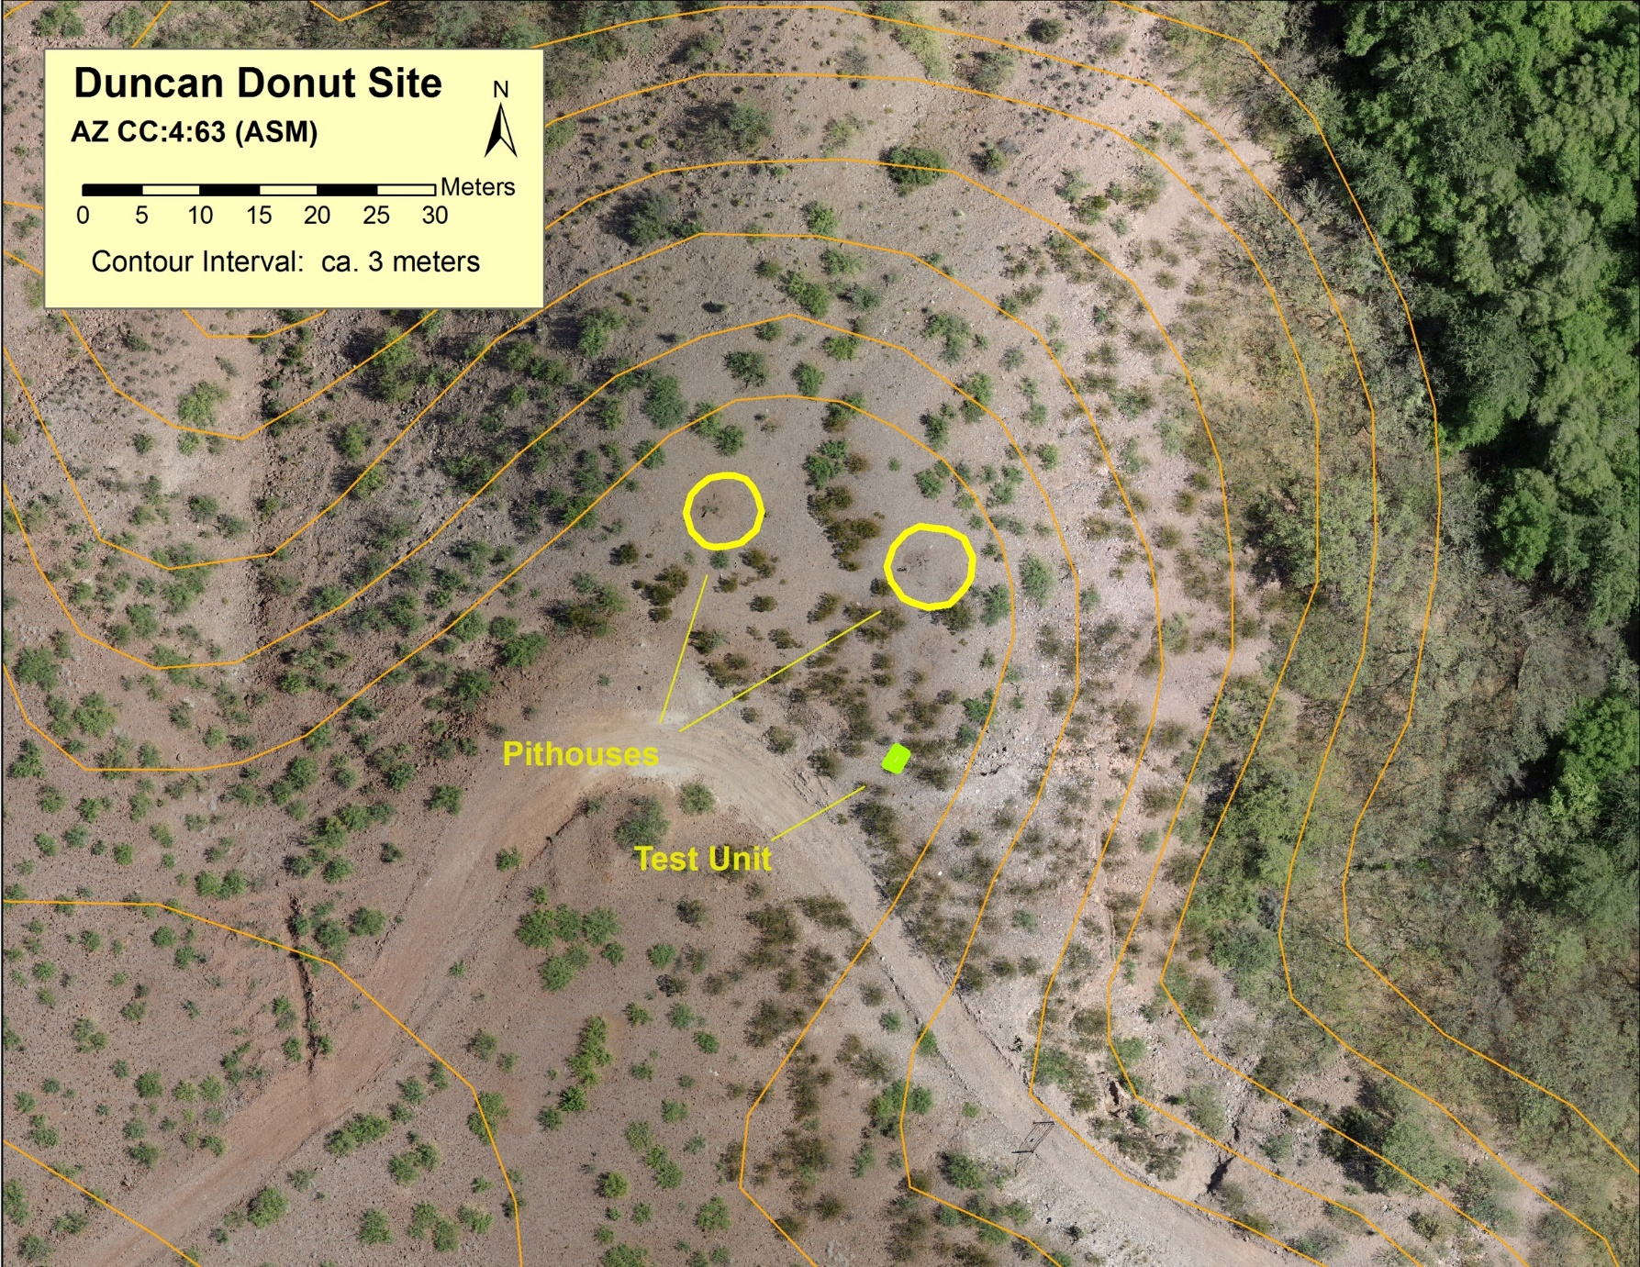
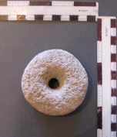
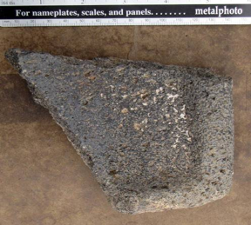
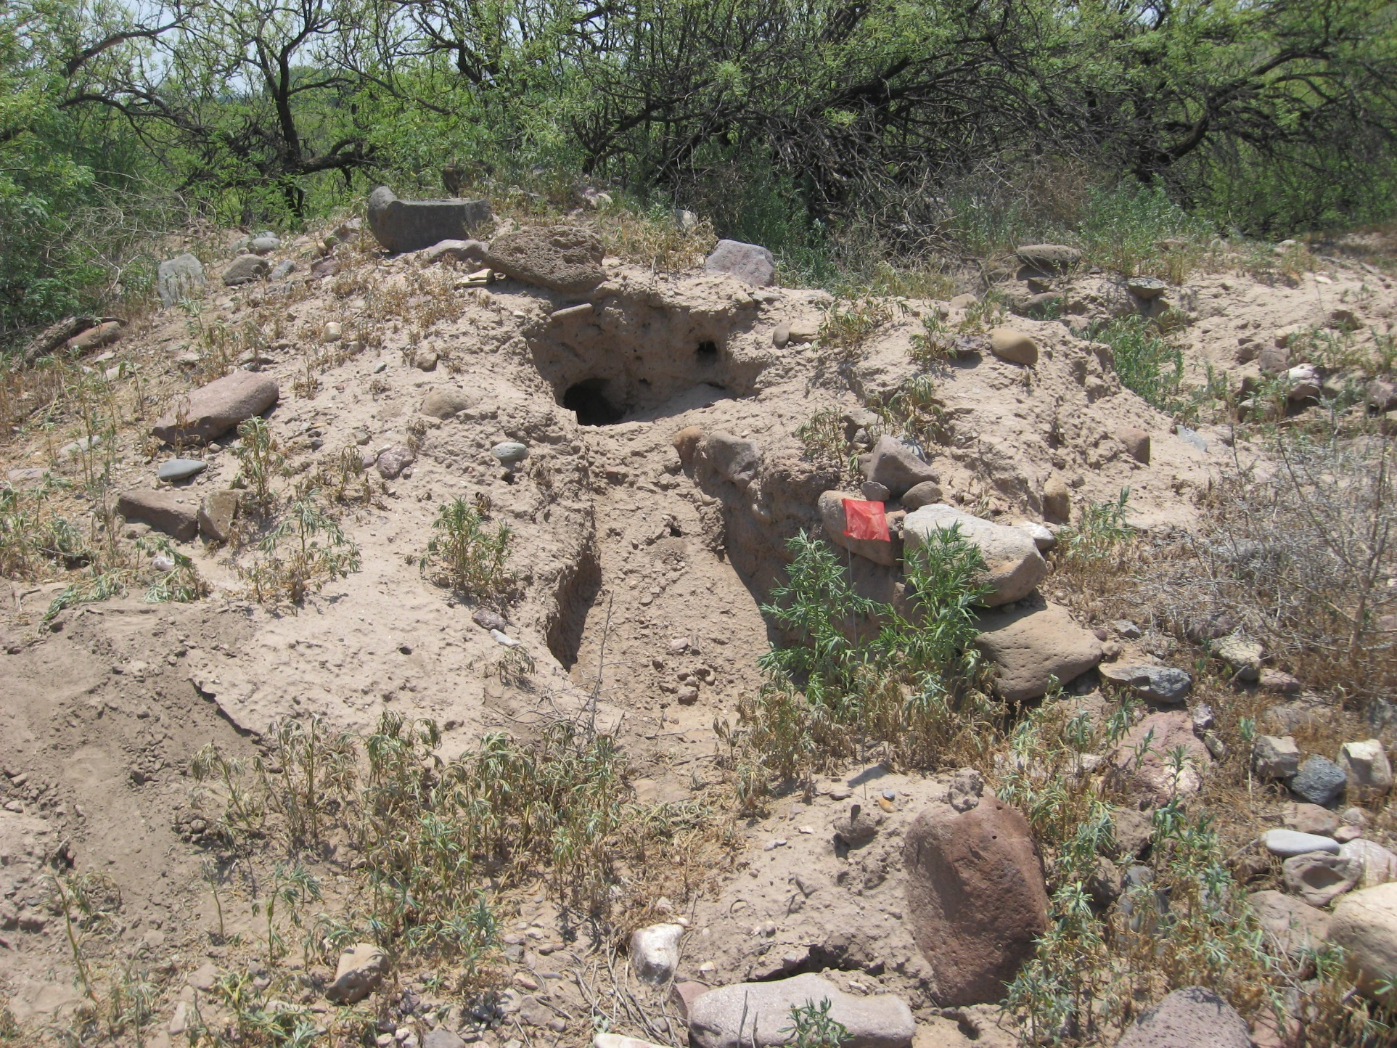
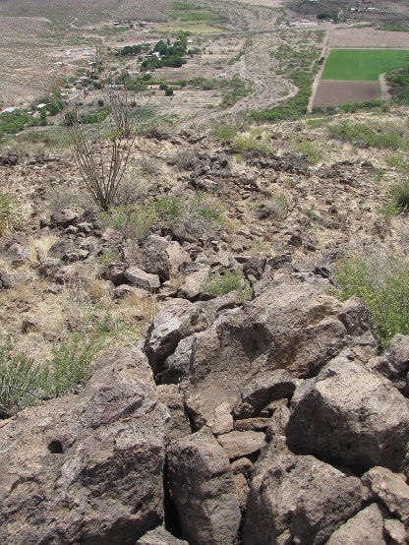
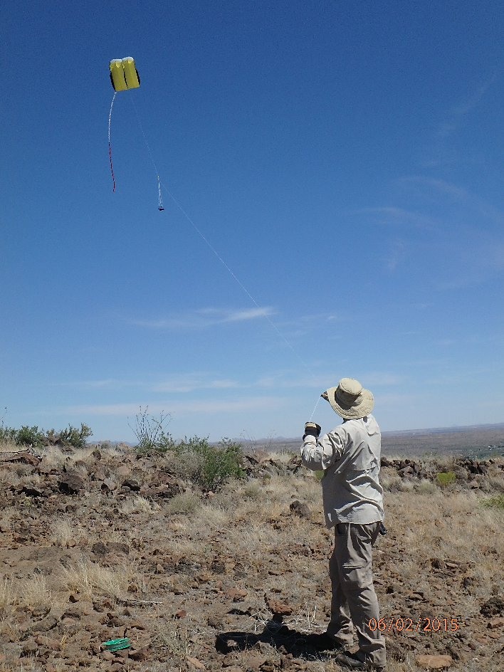
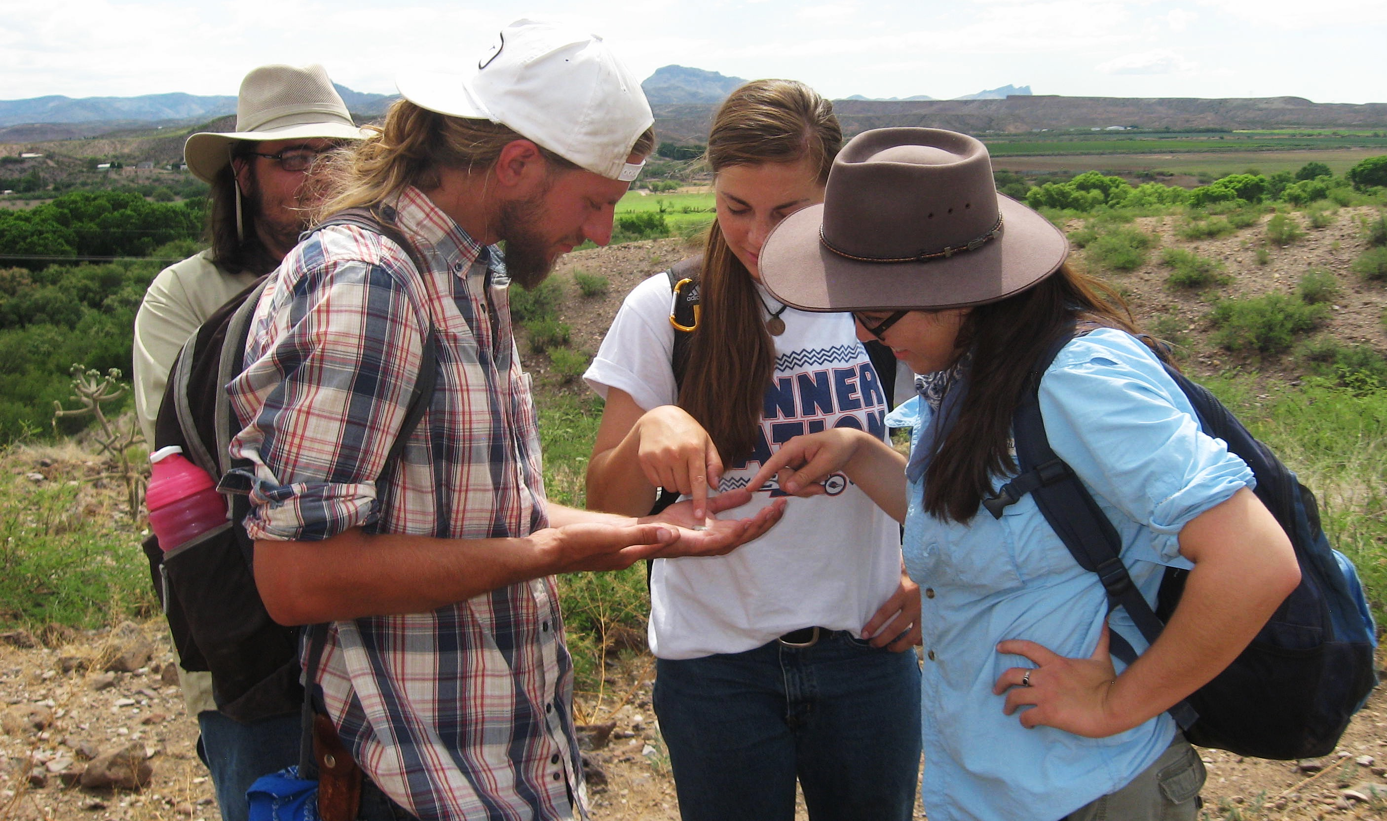
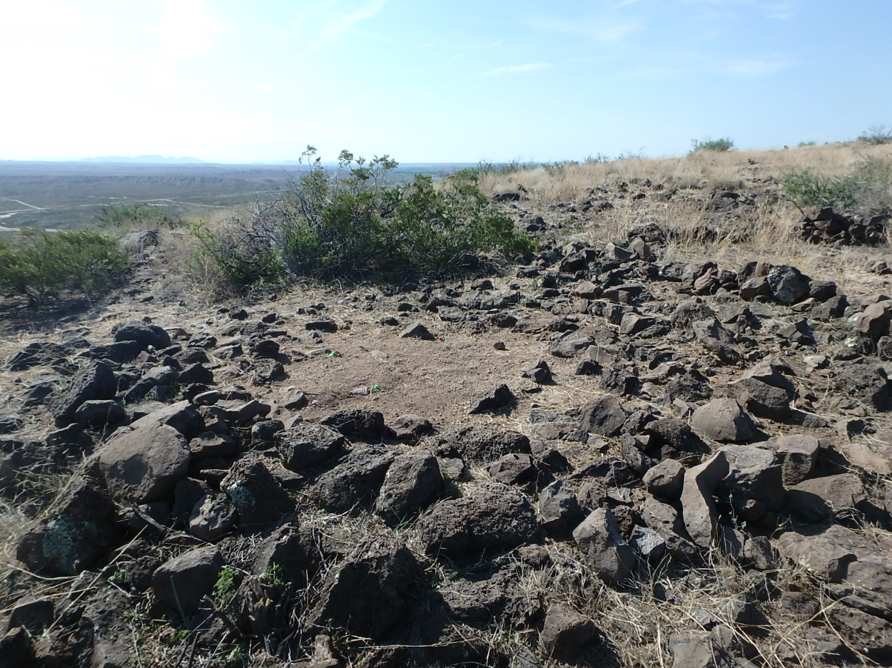
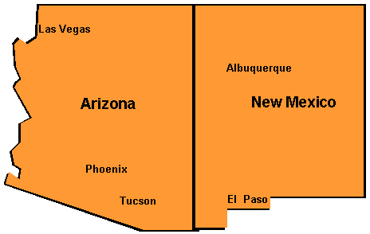
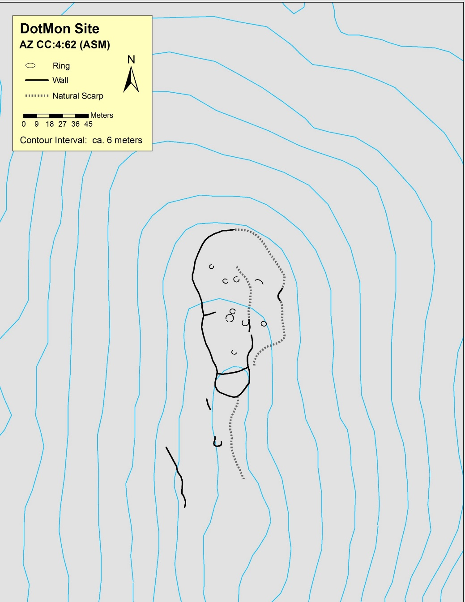
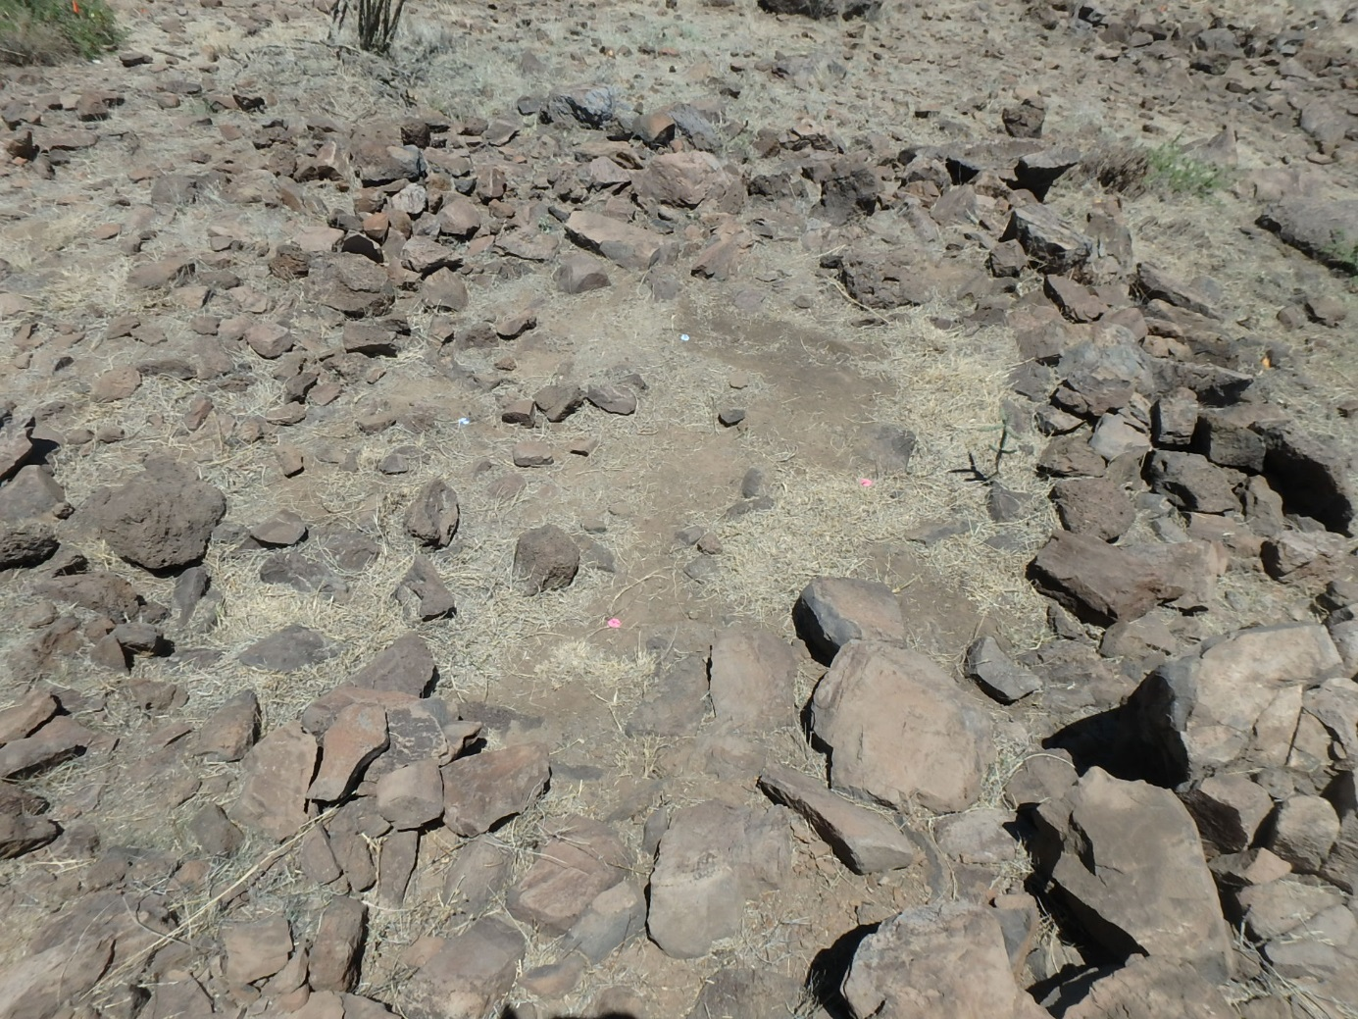
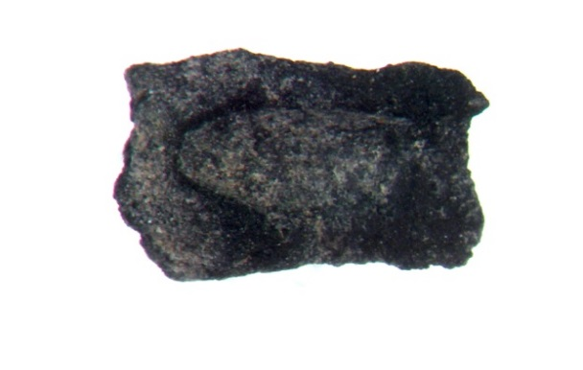
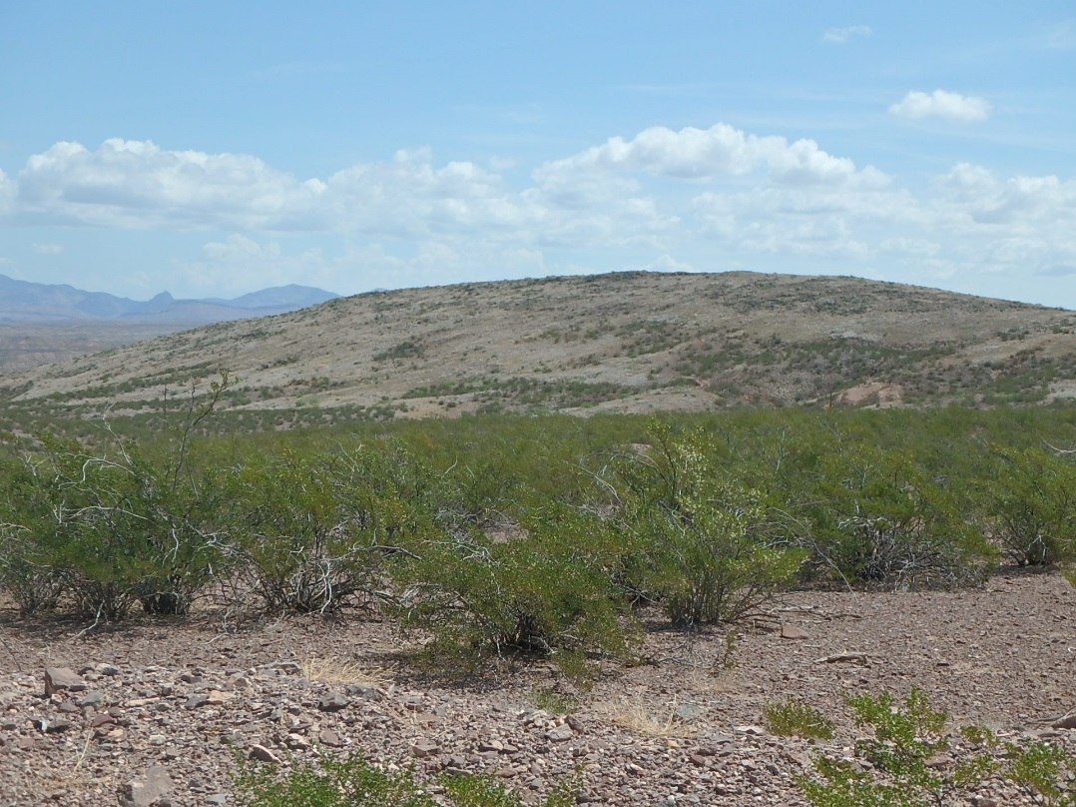
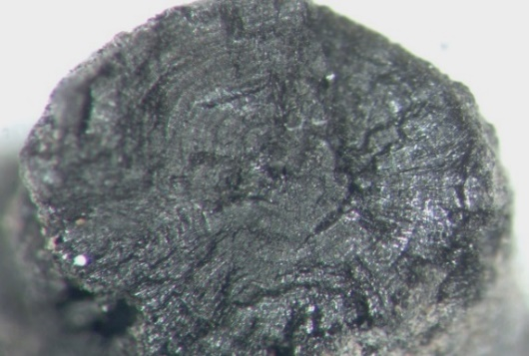
University of Texas,
San Antonio
&
Colinas Cultural Resource Consulting
Round Mountain and Other Cerros de Trincheras of the Upper Gila River, Arizona
Robert J. Hard, John R. Roney, A.C. MacWilliams, Karen Adams, and Mary Whisenhunt
Additional Information @
robert.hard@utsa.edu
Overview
Riverine Terrace Site
Survey and Site Recording
Ongoing Research
Recent work in the Upper Gila River Valley of Arizona documents two Early Agricultural period cerros de trincheras and a riverine residential site. This presentation summarizes recent field work and addresses issues related to chronology, the role of agriculture, and warfare. Early Agricultural period cerros de trincheras have been previously documented in the Río Casas Grandes and in the Tucson Basin. The Upper Gila River Valley sites expand this phenomenon to a third major river valley implying that cerros de trincheras are part of a broad regional pattern during the pivotal Early Agricultural period.
As part of the 2015 UTSA Field School project, we completed class III survey of approximately 112 acres near Round Mountain, and recorded 15 new archaeological sites. We targeted landforms which seemed most likely to yield archaeological evidence from prehistoric times, particularly alluvial terraces above the Gila River floodplain, and the lower slopes of the Peloncillo Mountains near Round Mountain.
Using geographic information system tools (ArcGIS) as a method of evaluation, we explored whether the Round Mountain trincheras site is defensively positioned. We conducted slope, cost path, and viewshed analyses of the hill and its human constructions to determine the extent to which the walls, terraces, and its position at the summit offered defensive benefits.
Cerros de Trincheras
Salado roomblock
Round Mountain [AZ CC:4:61 (ASM)]
Round Mountain constructed wall
The Duncan Donut site is located on a Pleistocene terrace overlooking the Gila River. Surface examination, test excavations, and radiocarbon dating suggest that this is an Early Agricultural period occupation with two pithouses. Flotation samples taken in 2015 revealed charred maize cupules with a 2 sigma calibrated, multiple intercept radiocarbon date of 350 – 105 B.C., suggesting that early inhabitants of the Duncan Valley invested in the labor necessary to maintain fields and tend crops.
Viewshed Analysis
Cost Path Analysis
Survey team members examining artifacts
Initial conclusions. The slopes of Round Mountain and its basalt cobble and boulder composition provide the strongest defensive quality of the site. The defensive contribution of the walls provide secondary support. Taken all together, the site’s steepness and constructed features offer a layered, defense-in-depth that would have provided significant protection to trincheras inhabitants.
Structures
Structure A, DotMon site, note massive wall fall, interior diameter 2.7 m, entryway and view to east.
Rock Rings representing house structures are found on Early Agricultural period sites. Lower walls stood perhaps 0.5 m high and median interior diameter is 3.1 m. (n=23, IQR=0.9). Most are circular, but some are ovoid and semicircular and 13 have associated ground stone.
Mark Willis conducting kite aerial photography
Round Mountain contains 1.9 km of walls and terraces and 16 rock rings and was constructed on a 640-foot hill during the Cienega phase (ca. 800 B.C. – AD 100).
Recorded sites included four Archaic/Early Agricultural period architectural sites (AZ CC:4:68, 74, 80, & Donut site), two large Early Ceramic period pithouse sites, an Early Ceramic period cerro de trincheras (North site), a post-Mimbres multiple roomblock settlement with a preceramic/early ceramic component, and a large Salado pueblo.
Conclusions
Multiple Cienega phase cerros de trincheras and riverine terrace sites indicate the Upper Gila River too contained substantial Early Agricultural period settlement. Radiocarbon dates, artifact assemblages, and Zea mays are broadly consistent with Cienega phase data elsewhere. The early inhabitants had the capacity to organize labor necessary to construct cerros de trincheras as well as care for fields. The Early Agricultural period cerros de trincheras in the Upper Gila River, Tucson Basin, and Río Casas Grandes indicate a previously unrecognized broad regional pattern and suggest defense was an ongoing concern.
The DotMon site is situated on a 400-foot ridge above the river and includes 250 m of walls and seven rock rings. Artifacts suggest it belongs to the Early Agricultural period.
Ethnobotany & ¹⁴C Dating
Charred Zea mays cupule from Duncan Donut site
Duncan Donut charred Juniperus twig; > 20 rings
Structure B, Round Mountain, interior diameter is 3.0 m, view to northeast.
Round Mountain. Juniper, mesquite, & oak wood dominates & grass culm base fragments present. Radiocarbon dating of a saltbush fragment produced a two-sigma calibrated date of 510 to 395 B.C.
DotMon. Juniper, oak & cottonwood/willow wood are in flotation samples.
Duncan Donut. Juniper, mesquite, Fabaceae (acacia?), & creosote bush wood are present. Maize is represented with four cupules, dating from 350 – 105 B.C.
DotMon [AZ CC:4:62 (ASM)]
Acknowledgements: BLM -Dan McGrew & Matthew Basham, Dick Kaler, Freeport-McMoRan-Bob Bigando, Simpson Hotel-Deborah Mendelsohn, Jacob Freeman, Mark Willis, Gary Huckleberry, Fred Nials, John Sandor, Students-Lori Barkwill-Love, Ashley Jones, Kristina Solis, Andrea Thomas, Ian Bates, David Barron, Meghan Brown, Stephanie Dooley, Rosa Compean-Molina, Haley Fishbeck, Robert Gardner, Lesley Overton, Kimberly Martin, Gabriella Zaragosa, & UTSA-VP Research, UTSA-CAR-Ray Mauldin, Leonard Kemp, & UTSA Anthropology.

